Slide 1
Body Paragraphs & Action Plan 5/13/15
LO: Can I create body paragraphs using my research?
Welcome Work: 1. Get a computer and log in.
2. Save your PS Research Outline in the S Drive in the correct class folder.

Slide 2
FYI:
Problem-Solution Essay→ part of your EXAM GRADE
Problem-Solution Project→ 6th 6 Weeks grade

Slide 3
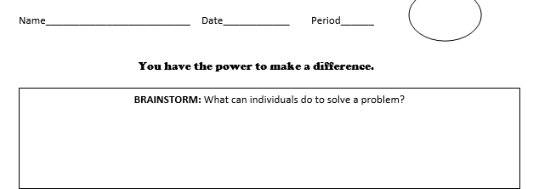

Slide 4
What can we do to help?

Slide 5
PERIOD 1: What can we do to help?
Personally do the right thing
Volunteer
Educate others
Acting as a role model/self-reflect
Raise awareness
Start an organization
Create a pledge
Social Media
Instagram
Twitter
Start a hashtag
Petition
Write a letter to gov’t
Donate to a fund
Non-violent protest
Developing empathy (simulation)

Slide 6
Body paragraph: 6 sentences
Topic sentence
IQ, Evidence 1
Explain
IQ, Evidence 2
Explain
Concluding sentence
IQ= INTRODUCE QUOTE!

Slide 7
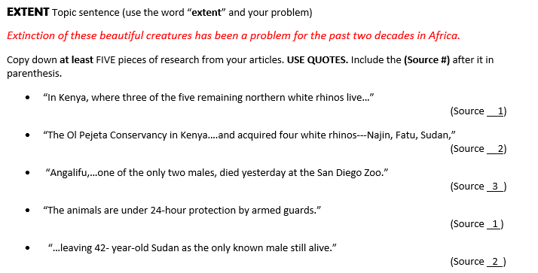
Step 1: Select your best pieces of evidence.

Slide 8
Step 2: Open up Body Paragraph Grids
Save it as “Pocket # Last name PS Essay”
Example→ 15 Smith PS Essay

Slide 9
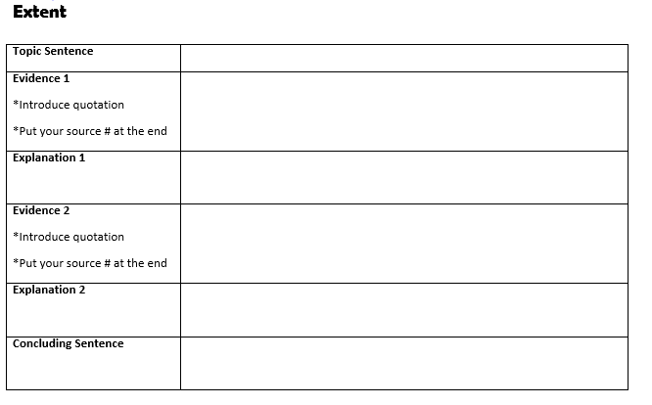

Slide 10
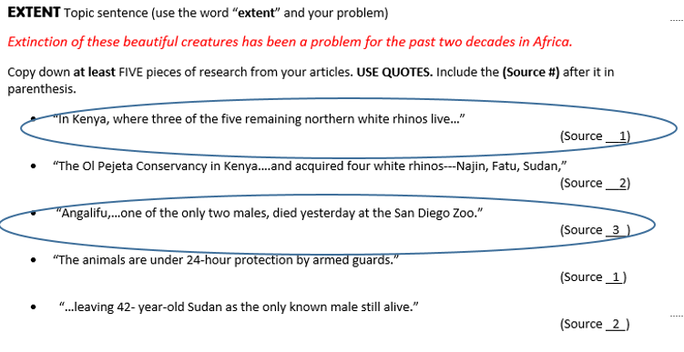
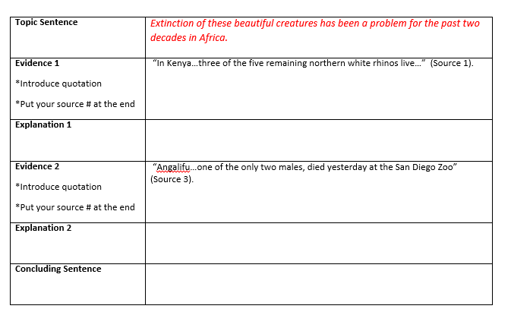
Step 3: Copy your topic sentence and 2 pieces of evidence to the essay.

Slide 11
Step 4: INTRODUCE QUOTES

Slide 12
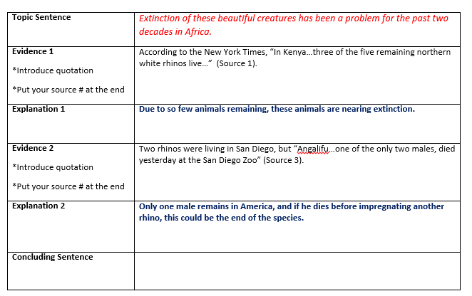
Step 5: Add explanation sentences after the proof.

Slide 13
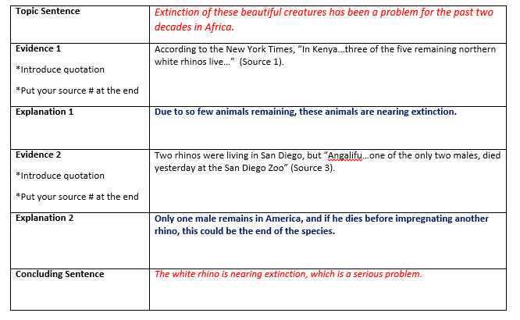
Step 6: Add concluding sentence

Slide 14
HOMEWORK:
Due Friday, May 15
Completed body paragraph grids
Save in S Drive!
Action Plan worksheet
Next class period→ GMRT! (one hour)

